Slide 1
Olympics – Project 1
Group 7 –
Benjamin Bagby
Traci Ellis
Katrina Medina
Homar Ortiz

Slide 2
Olympics – Background
The Olympic Games had their start during the year 1896. During the first two Olympiads, first place winners were awarded a silver medal and an olive wreath, while second place winners were awarded a bronze/copper medal and a branch of laurel. However, in 1904, the International Olympic Committee began awarding gold, silver and bronze medals to the top three finishers in every event, a tradition that first took place at the St. Louis Olympic Games. Since then, more than 35,000 medals have been awarded during the Olympic Games.

Slide 3
Olympics – Content
The dataset we chose includes a row for every Olympic athlete who has been awarded a medal in both the Summer Olympics, and Winter Olympics since their inauguration, up until 2014.
However, for the purpose of this project, we will only be focusing on the Olympic Games held after World War II (1948-2014)
Each group member has posed a question regarding the data and have performed the necessary analysis to answer the question and present their findings.

Slide 4



CSVs Provided
Dictionary CSV
Summer Olympics CSV
Winter Olympics CSV

Slide 5
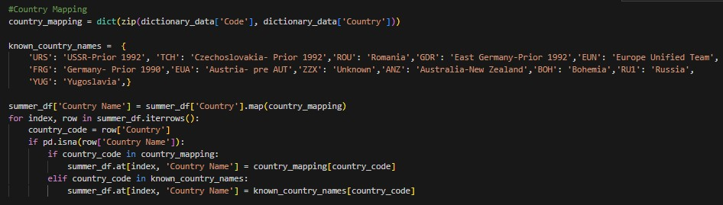

Cleaning Up The Data - Group
Country Mapping
Updated Data Frame

Slide 6
Olympics – Questions
Which Country has won the most medals, overall, in the Summer Olympics? We will be looking at 3 individual events of the sport of Gymnastics (Vault, Individual All Around, & Floor Exercises) where men and women were equally represented. - Traci
One of the most popular Olympic event categories is Track & Field. Which countries have had historical success in the events under the umbrella of the Track & Field category? - Benjamin
For Speed Skating, how much of an effect does the population of a country correlate on whether that country would receive the most medals? – Katrina
Which are the top 3 countries with most medals won (per athlete, not event) per competition? How has this changed over time? How does it compare between the Summer/Winter Olympics? - Homar

Slide 7
Question #1 - Traci
Which Country has won the most medals, overall, in the Summer Olympics? We will be looking at 3 individual events of the sport of Gymnastics (Vault, Individual All Around, & Floor Exercises) where men and women were equally represented.

Slide 8
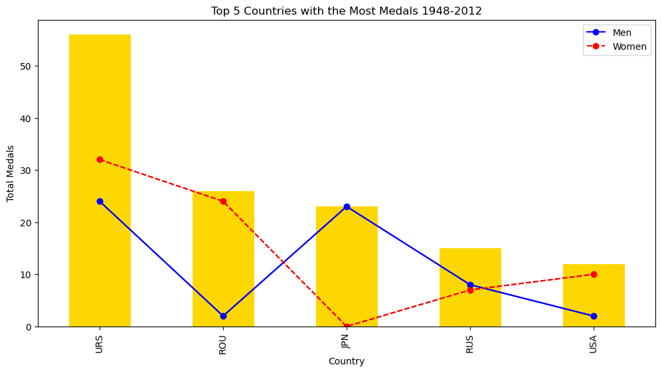
Top 5 Countries with the Most Medals
URS- USSR Prior to 1991
ROU- Romania
JPN- Japan
RUS- Russia Post 1991
USA- USA
Notes:
On average, over the course of a Summer Olympiad, there are over 200 countries that are being represented. Take into effect, for each event, about 30-40 participants per event and for 3 events like the Vault, Floor Exercises and Individual All Around we could have approx. 120-160 athletes competing for Gold. Only one Gold Medal per gender is awarded per event. From 1948-2012 there were 144 medal winners from their respective countries. But, who were the top five countries who had the most medal winners?

Slide 9
USSR vs. USA a Timeline Analysis
Notes:
From 1950 until 1990 – the USSR was a powerhouse in the field of Gymnastics (specifically in the 3 events analyzed), as you can see from the data the US never won a medal in the 3 events until about 1976. And even then, the USSR surpassed the US by winning 6 medals compared the the US’s 1 medal during that same year. After the fall of the Soviet Union in 1991 we do not see a Eurpoean uptick again until the 1994 games when post USSR, Russia brings home the most medals that year. The Post USSR Countries that won medals in our dataset included Russia with 15 medals, Belarus with 1, Ukraine with 2 and Latvia with 2 medals. Even with the breakup of the Soviet Union it is clear to see that they remain a powerhouse in the sport up to 2012.

Slide 10
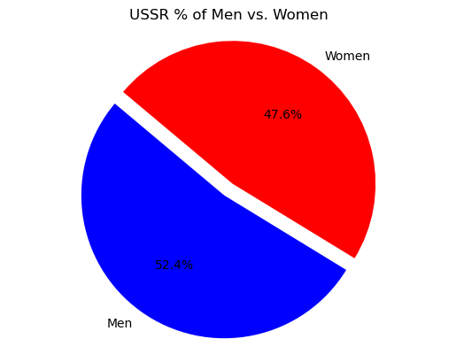
USSR % of Men vs. Women
Notes:
From 1948 to 1991 the USSR- Soviet Russia was a powerhouse when it came to the sport of gymnastics especially in the co-ed events of the Vault, the Individual All Around and the Floor exercises. if we were to do a deeper dive, and include all events we would probably see an increase in those medals. I only wanted to look at events that both men and women competed in individually and removed all team events and single gender events. After the fall of the USSR the Soviet Union was broken into their own independent countries and i wanted to see if those coutries would have still contributed to the USSR's success after post 1991. and Russia along with 3 other countries combined brought home an additional 20 medals after 1992. we can further see from the data that the United States did not become more competitive in the sport of gymnastics until after 1978.

Slide 11
Question #2 - Ben
Which countries have brought the most medals back home since the end of World War II?
In this analyzation, only individual events will be taken into consideration
Medal totals will be broken up into 4 categories (Gold, Silver, Bronze and Total)
The top countries will be compared against GDP per capita to see if there is any correlation

Slide 12
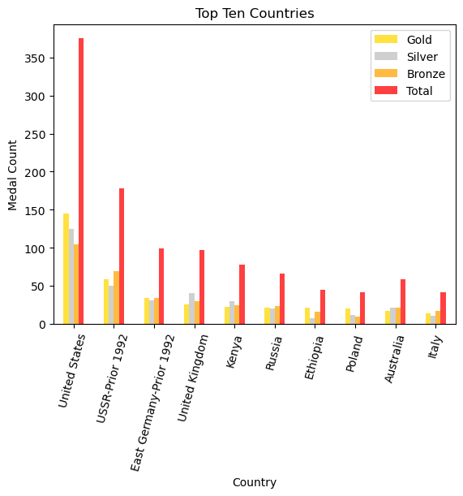
The Top Performers
Observations
The two post WWII superpowers (USSR and USA) were the most dominant
English speaking nations are amongst the elite track and field athletes
Outside of the top 2 performers, medal share seems to be evenly distributed

Slide 13
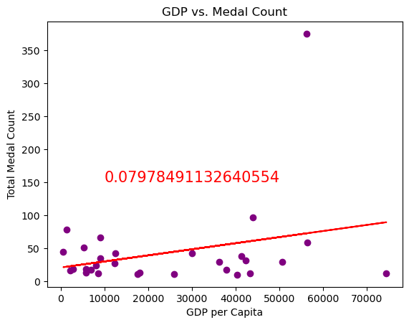
GDP per Capita Comparison
Observations
There appears to be one statistical outlier (probably the USA)
With a r² value of .079, there seems to be little to no correlation between the two variables
There would be almost no relationship if the statistical outlier was taken away from the model

Slide 14
Question #3 - Katrina
For Speed Skating, how much of an effect does the population of a country correlate on whether that country would receive the most medals?
.

Slide 15
Speed Skating & Population
1948 was the first year back for the Olympics after the toll and devastation of the second World War.
WWII created a spilt all over the world.
To reunite after the devastation, the Olympic committee decided to bring back both the summer and winter Olympics in the same year, after a 12-year standstill.
I wanted to see if the results of speed skating and the overpopulation of a specific country would have an affect on the success rate of bringing home the most medals.
Notes:
In 1948 it was the first year back for the Olympics return due to the devastation of the Second World War. Due to WWII it created a split all over the world, once the war had ended both Summer and Winter Olympics mad their comeback after a 12 year standstill. The topic I chose to discuss was concerning the results of speed skating and whether or not population had an effect on the success rate of taking home a medal.
What I first discovered were the amount of medals won for speed skating during the years 1948-2012.
After retrieving this data from the CSV I limited it to the top 10 countries during that timeframe and created this graph depicting how many medals were won by country and I also separated it by men and female medals.

Slide 16
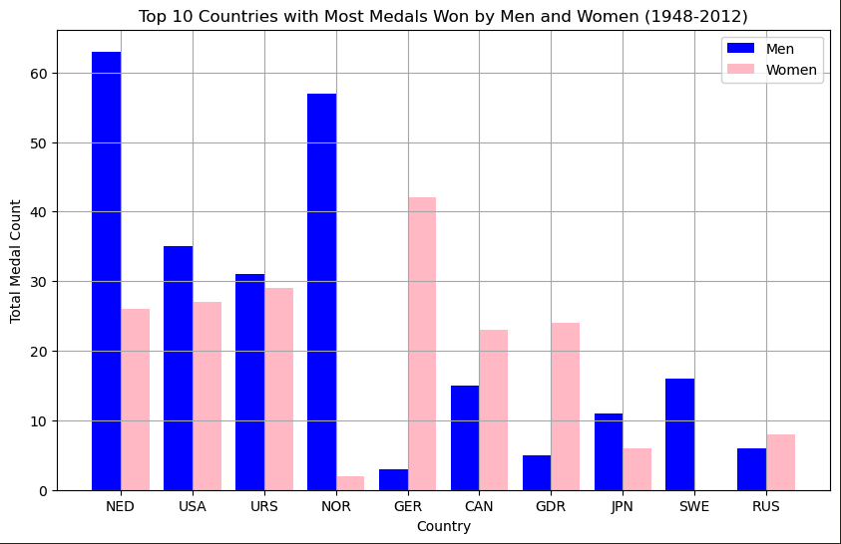
Top 10 Countries with the Most Medals
Notes:
Once I had this information, I had to gather the population of each country from the dictionary CSV. I didn’t have all the necessary findings due to the splitting of certain countries (East Germany & USSR) so I found my data online and added it to the dictionary CSV. I took the population of the country the year before they were disbanded.

Slide 17
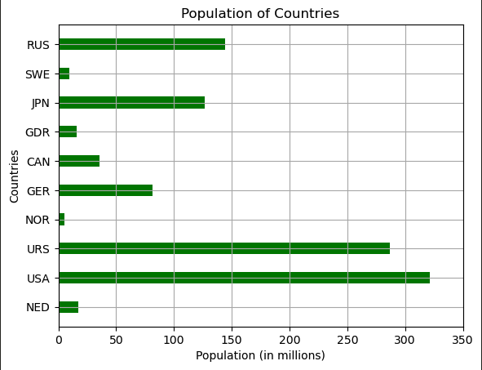
Top 10 Countries with Population
Notes:
I created another graph showing the top 10 countries with medals and their population. From our first graph you can see the top 3 winners are Netherlands, USA, and USSR. The outcome makes perfect sense for USA and USSR. For Netherlands results you can see they have the 3rd smallest population on the list but with the most medals won. With these results you can see population isn’t necessarily a determining factor of the success rate of Olympic Medals

Slide 18
Question 4 - Homar
How has the top 3 countries with most medals per athlete changed over time? How does it compare between the Summer and Winter Olympics?
To answer this question, I decided to analyze both Summer and Winter Olympics results at intervals of every 8 competitions.
This means we will be looking at the results of the 1948, 1980, and 2012 Summer Olympics. And the results of the 1948, 1980, and 2010 Winter Olympics.

Slide 19
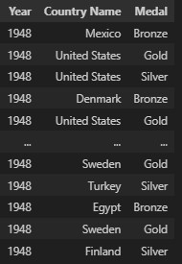

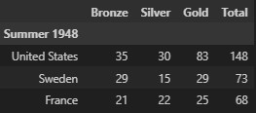
Analyzing the Data - Homar
Data Frame for Analysis
For Loop – Creating New DF
DF for Plotting

Slide 20
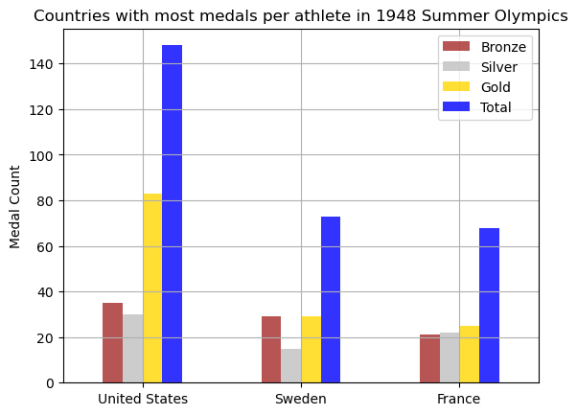
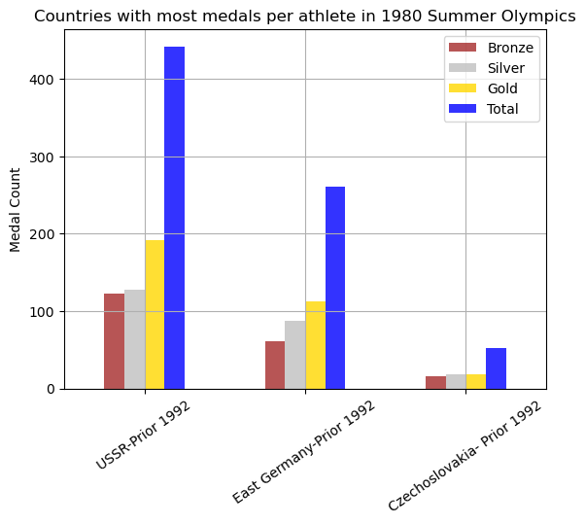
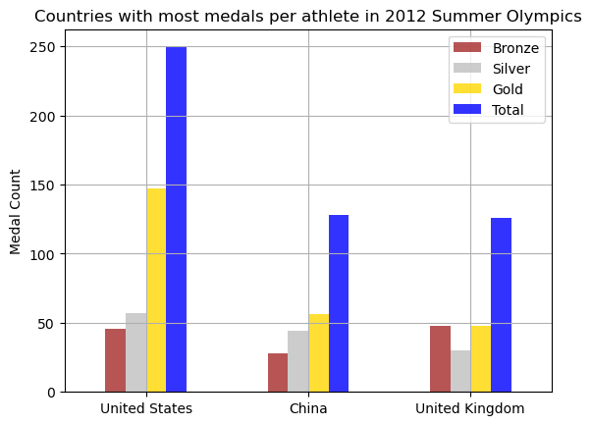
Results – Summer Olympics

Slide 21
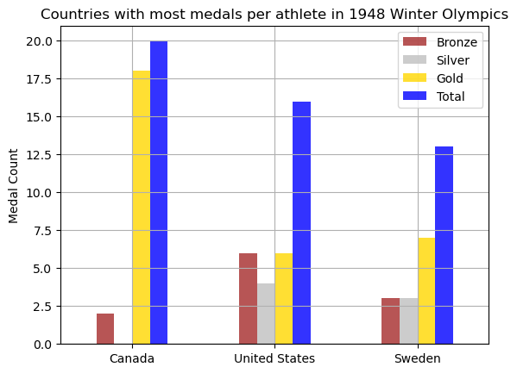
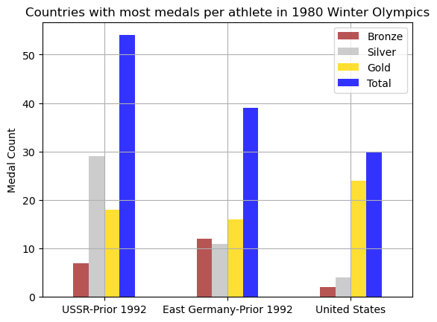
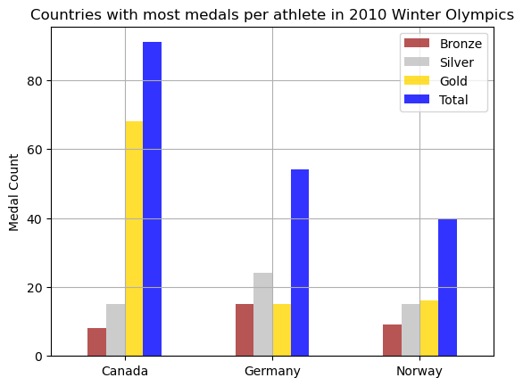
Results – Winter Olympics

Slide 22


Results – Summer vs Winter Olympics

Slide 23
Conclusion
We learned that to apply great data we need clean data.
We worked together to code and clean the data to apply the missing blanks to find the answers to our current questions.
Further exploration and cleaning of data would be needed if we wanted to further expand on our hypotheses.
NEXT STEPS:
The possibility of forecasting to determine which countries have the greatest chance to win medals.
Cleaning up the data to include current countries, added competitions that were not present in our current data.

Slide 24
Any Questions?

